Slide 1
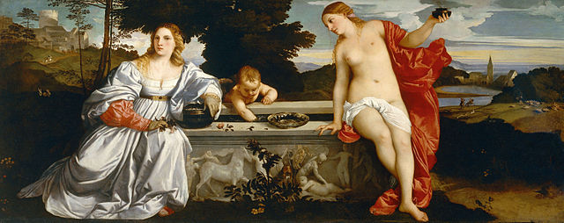
History 336
Ideas and Society in Early Modern Europe:
The Debate about Gender and Identity

Slide 2
Vives: Writing to / about widows
Sources: the regular suspects with an emphasis on Christianity (pp. 303-304, 311, 313)
classical references (p. 305)
New Testament (pp. 312, 315)
Church Fathers (pp. 309, 316, 323, 325)
shaming strategy: pagans vs. Christians (p. 309)
rhetoric of reproach (pp. 310, 311)
chastity remains supreme virtue (pp. 311, 318, 320)

Slide 3
Lucrezia Marinella (1571-1653)
learned Venetian woman from a prosperous family
intelligent but secluded
writer: epic poetry, saints’ lives
polemic in favour of women and against men: Nobility and Excellence of Women and the Defects of Men (1600 / 1601) vs. Giuseppe Passi, The Defects of Women (1599)

Slide 4
Questions for 25 February
What passages from the reading assigned for today strike you as historically significant?
What continuities and discontinuities exist between what you have read by Vives (1493-1540) about widows and (a) what you have read about virgins and wives and (b) what you have learned so far about women and gender in early modern Europe?
After reading the introduction to the writings by Lucrezia Marinella (1571-1653), what continuities and discontinuities do you notice with respect to (a) what you have learned about women and gender in early modern Europe and (b) what you have read in Vives?

Slide 5
Questions for 25 February
What is the ideal widow according to Vives? What should a wife not be like?
Remember what Joan Scott says about gender: “gender is a constitutive element of social relationships based on perceived differences between the sexes.” Where do you see the relational aspect of gender in Vives’ book in general and in his section on widows in particular? What can we say about Vives’ thinking about gender?
Can you formulate at least one historical question based on the assigned reading to start a larger discussion?

Slide 6
Questions to consider for the rest of the course
What passages strike you as historically significant? Mark them and write them down.
What positions on women and gender does a given primary source take on women and gender? How does the author support these positions?
Can you formulate at least one historical question based on the assigned reading to start a larger discussion?
Can you find a few secondary sources (and other primary sources) by using the library catalogue and databases that will help you answer your historical question?
Can you think of any current news stories that relate to women and gender?

Slide 7
In the news
Stephanie Nolen, “Break Caste: Why this 13-year-old's parents want her married despite India's laws,” Globe and Mail, 23 February 2013, http://www.theglobeandmail.com/news/world/breaking-caste/why-this-13-year-olds-parents-want-her-married-despite-indias-laws/article8993124/ [Thanks, Lynne!]
“Labour to examine opportunities for older women in public life,” BBC, 24 February 2013 http://www.bbc.co.uk/news/uk-politics-21564395

Slide 8
In the news
“Park Geun-hye sworn in as South Korea president,” BBC, 24 February 2013, http://www.bbc.co.uk/news/world-asia-21570512

Slide 9
Annotated bibliography
How did Peter Canisius SJ edit the letters of the Church Father, St. Jerome?
Lössl, Josef. “Konfessionelle Theologie und humanistisches Erbe: zur Hieronymus-briefedition des Petrus Canisius.” In Petrus Canisius SJ (1521-1597): Humanist und Europäer, edited by Rainer Berndt, 121-50. Berlin: Akademie Verlag, 2000.
Lössl argues that Canisius’ edition of St. Jerome is more a product of humanist editorial traditions than of confessional polemics of the Reformation era. He states that Canisius followed the editorial principles of Erasmus, the great humanist editor of Jerome.

Slide 10
Annotated Bibliography
Rice, Eugene F., Jr. Saint Jerome in the Renaissance. Baltimore: Johns Hopkins University Press, 1985.
Rice’s book remains the authoritative study of the reception of Jerome in the period 1400-1600. Chapter 6, “Between Protestants and Catholics,” mentions Canisius in the context of the Catholic effort to use Jerome as support for Catholic doctrine and devotion in the sixteenth century.

